Slide 1
Identifying Quora Question Duplication
Team members:
Desmond To Cie Hong
Xing Zheng
Chi Sern
Gordon Yit Hongyao
Pua Li Xue
Wee Han
Notes:
Good day! We are from team 18 and here we are going to present you our blood, sweat and tears in this semester. The title of our project is “Identifying Quora Question Duplication”!

Slide 2
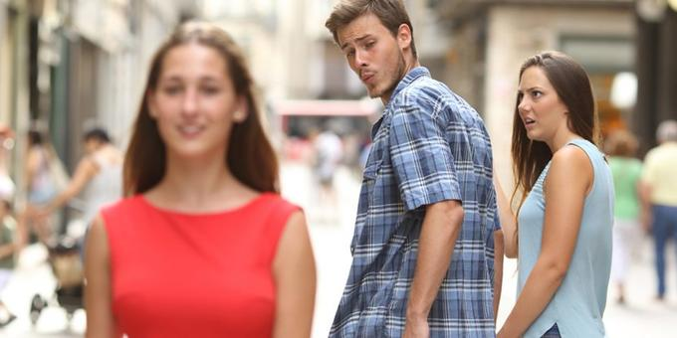
Our Characters
Alice🤷‍♀️
💁🏼‍♂️Bob
- CS3244 student
- Curious and creative
- CS3244 student
- Always pay 100% attention
- Never sleep in class
Notes:
Presenting in a normal way is boring! Instead, let me introduce you two CS3244 students who helped us in this project Alice and Bob. Are you excited to witness how they are going to tackle our day-to-day problem? Let us begin!

Slide 3
Motivation
🤩
In the past, many Q&A platforms like Yahoo and Google Answers had failed to maintain the content value due to a lot of junk/duplicated information posted, and hence the decline in their user base.
Therefore, identifying semantically identical questions on Question and Answering(Q&A) social media platforms is exceptionally significant to ensure that the quality and the quantity of content are presented to users.
References:
1. Why did Yahoo! Answers decide it would be OK for multiple people to ask the same question over and over?
2. Wisdom in the Social Crowd: an Analysis of Quora
Notes:
Well, you know, every project has a purpose. Our project is no exception. It starts when Alice wonder why big tech company like Yahoo and Google failed their Q&A platform product. Although Bob never ask for it, but she then tell Bob her hypothesis. She said: “There are too many duplicated information. We must identify them to ensure the quality and quantity of the content!”

Slide 4

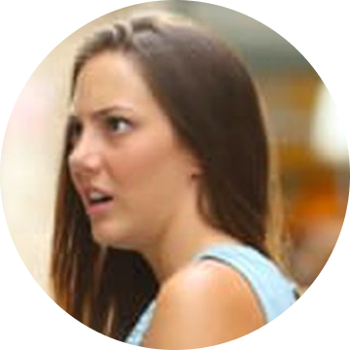
Why is determining question similarity difficult?
Are Donald Trump supporters naive?
Are the supporters of Donald
Trump dumb?
Notes:
But, detecting duplicate questions is a challenging problem! Here is an example, these two questions look the same but 'naive' vs 'dumb' makes them different semantically. Alice asked: “What if we are able to determine identical question using computer, maybe with Machine Learning?”

Slide 5
MILLION-DOLLAR PROJECT!
🤑
Notes:
Bob says: “Then it will be a million-dollar project!”

Slide 6
Research on these! 📚
Which set of characteristics or algorithms are more important in categorizing the questions with similar intent?
By how much will neural network outperform the traditional models (that are in research question 1)? Does neural network always perform better?
Notes:
Very quickly, they listed down two research directions for the project! First, what are characteristics make two questions similar and if neural network will outperform tradition models?

Slide 7
What has been done?
🧐
As Quora Question Pair is a publicly available Kaggle challenge, there has been many attempts to solve the question and optimize the solutions. Alice and Bob decided to take a look and learn from the past attempts.
Notes:
After that, they start working on it. Of course, they also did not forget to checkout on Kaggle to see what people attempted in the past.

Slide 8
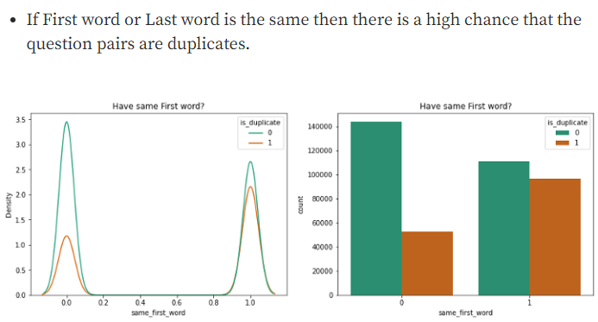
Attempt 1: Using intuitive linguistic rules 📏
Use features such as “whether the first and last word of the questions match” as a factor to determine the likelihood of similarity.
They consider this attempt naive, as it is not always generalizable given that questions with the same semantic meaning do not always satisfy such constraints, such as “how do I…” and “in what ways can I…”. This feature is also not backed by any scientific evidence but just an intuition.
Reference: https://towardsdatascience.com/the-quora-question-pair-similarity-problem-3598477af172
Notes:
The first attempt is by checking if the first and last word of the questions match. But they think this attempt is naive! Not generalizable and not backed by scientific evidence at all.

Slide 9
Attempt 2: Bag of Words 🎒
Then, they discovered attempts that used NLP techniques such as Bag of Words. This method transforms a sentence into a one-hot vector based on its tokens.
Disadvantages:
does not consider the order of words in a sentence.
does not consider synonyms, which is a big issue for duplication checking.
Reference: Finding Similar Quora Questions with BOW, TFIDF and Xgboost
Notes:
Next, they discovered people also used Bag of Words for processing textual information. But it does not consider the order and synonym which is a big issue!

Slide 10
Attempt 3: Word2Vec ↗
Word2Vec generates embeddings after taking into account the semantic meaning of words and sentences.
Disadvantages:
same embedding for the same word in different contexts.
E.g. “which bank is the best to go to?” &“which river bank is the best to visit?” may have very similar embeddings and be classified as duplicates.
Reference: Word2Vec struggles to handle polysemy and homonymy
Notes:
They also found another technique, word to vec. However, they realized that same embedding could be generated for words in different contexts.

Slide 11
First Look at the Dataset 👁️
The dataset contains 6 columns.
The first column contains the id of the row, while the second and third column the individual question ids.
The next 3 columns contain the two questions themselves and lastly, whether the question pair is considered a duplicate, with 0 being a no, and 1 being a yes.
Notes:
So far, they found no solution yet. But Bob said: “Nevermind, let us first download some dataset and see how we can proceed from there!”. So they downloaded a dataset from Kaggle and inspecting it. This dataset contains the basic information like question id, question pairs and a label telling if the pair is a duplicate or not.

Slide 12

DATA CLEANING
✨
Notes:
Seems to be the dataset suitable for the project. So, they decided to clean the data first before anything because Prof taught them about it in the class.

Slide 13
Data Cleaning 🧹
Let’s apply what we learnt from CS3244 class to identify and mitigate data issues!
Sounds good! Let’s answer these questions:
1. What is the issue?
2. Why is it a problem?
3. When would it happen?
4. How to check for it?
5. How to mitigate it?
Notes:
Alice said: “Let’s apply the knowledge learnt in class” and Bob said: “Sure, there is a template we can use”!

Slide 14
Issue 1: Erroneous data
Why is it a problem?
Model learn from incorrect label and predict wrongly
When would it happen?
Human error when labeling the data
How to check for it?
Iterate through the data and find the wrong label for the exact same match
How to mitigate it?
Remove erroneous record or correct the label if possible
Notes:
Using the template, they identified the very first issue: erroneous data. It is a problem because model can learn from noise and predict wrongly. It happens due to human careless mistake. For this specific dataset, we can apply stemming and lemmatization on the question pair. If they turned to be exactly the same but labeled as not duplicate, we know that it’s a noise! To mitigate it, they just change to the correct label!

Slide 15
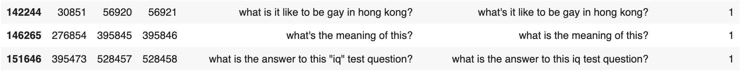
Mitigate Issue 1 🧹
Turn noise into useful data by correcting label
Notes:
Here’s what they did, for question like “What’s it like to be gay in Hong Kong?”, they changed the label from 0 to 1. Of course, there are more issues than this.

Slide 16
Issue 2: Imbalanced Data
Why is it a problem?
Evaluation metrics become misleading to interpret (Precision is affected)
Models overfit to majority class
When would it happen?
Uneven occurrence of events or data collection
How to mitigate it?
Collect more data instances for minority class
Resample instances (e.g., Undersampling, Oversampling, SMOTE)
How to check for it?
Visualize histogram or bar chart of feature values
Notes:
The second issue faced by Alice and Bob is the imbalanced data. Training on this dataset would cause the model to overfit to the majority class. To check for this issue, Alice and Bob visualized the bar chart of the two classes.

Slide 17
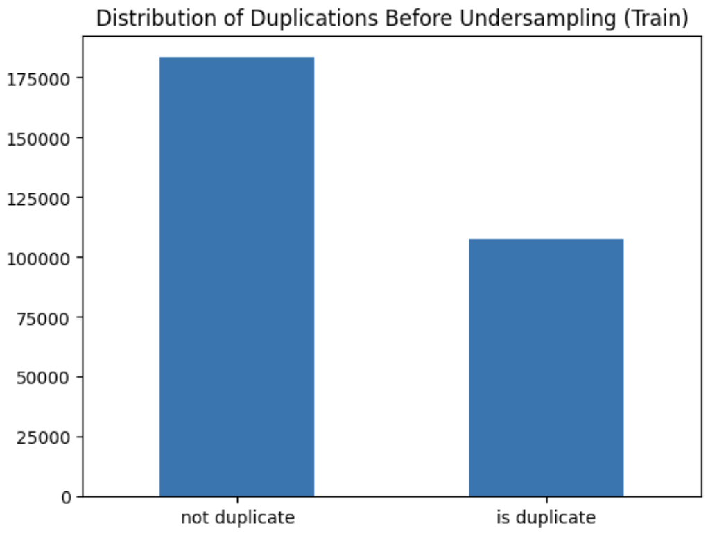
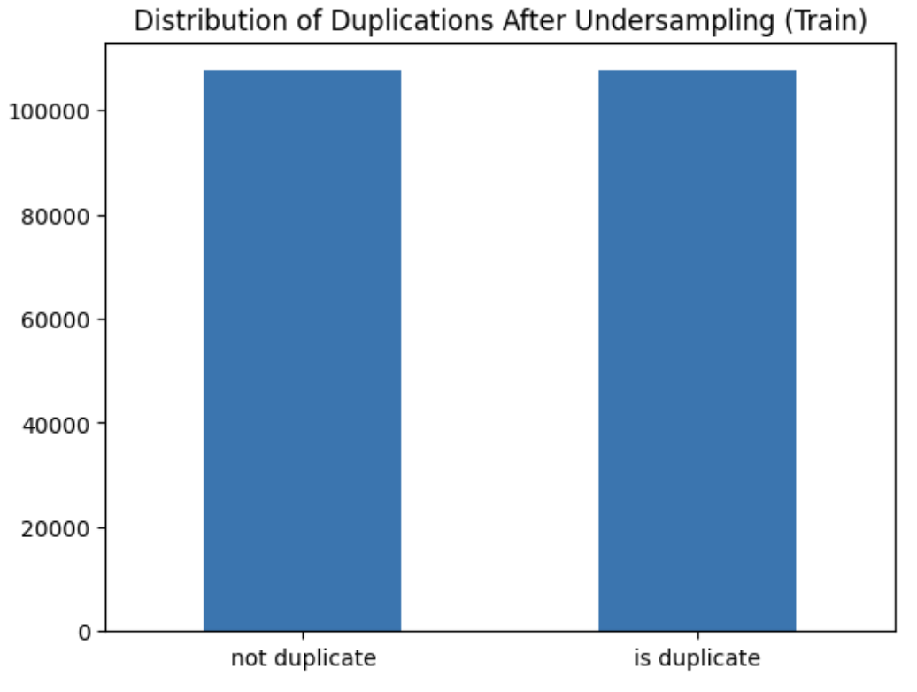
Mitigate Issue 2 🧹
Undersampling
Notes:
In this dataset, duplicate question pairs are the minority class. Thus, they decided to apply undersampling to reduce the instances of non-duplicates.

Slide 18
Why Undersample?
They have a large dataset (~363k instances)
14% reduction in number of samples
Oversampling increases the data and training time
SMOTE is not suitable as the vectors of texts are rarely separable in the feature space
Notes:
The reason that they used undersampling is because the existing dataset is large. After a 14% reduction in the samples, there were still enough data to be trained on. Besides, oversampling increases the size of the dataset and training time. SMOTE was also considered but it’s not suitable since the vectors of sentences are rarely separable in the feature space.

Slide 19
Generating Embeddings
We have seen Bag of Words and Word2Vec just now. Should we use them?
I’ve heard of a better sentence embedding generator called BERT. Let’s use this!
Notes:
After undersampling, Bob suggested to use a better sentence embedding generator called BERT.
—------------------
note
they found that sentence embedding generator is a powerful tool that can accurately capture the semantic meaning, and that some intuitive solutions may help with the classification. Thus, they decided to use BERT, one of the best performing sentence embedding generators trained with a large corpus, to transform the question pairs.

Slide 20
What is BERT and Why BERT?
Transformer-based language model trained on a large corpus.
Being bi-directional and having attention layers, BERT does not have the drawbacks of Bag of Words and Word2Vec.
Transforms each question into a 768-dimension feature vector.
Reference: BERT Explained
Notes:
Bob explained that BERT is a transformer-based language model. Because it is bi-directional and has attention layers, it can outperform Bag of Words and Word2Vec. Therefore, they used BERT to transform each question into a 768-dimension vector.

Slide 21
Issue 3: High Dimensionality
768 dimensions seem large! Alice is aware of The Curse of Dimensionality.
Features do not provide a clear and interpretable meaning
Notes:
Alice is aware of the curse of dimensionality and feels that 768 is a very large number. Besides, the features in the vectors do not provide a clear and interpretable meaning.

Slide 22
Recursive Feature Elimination
47 features are carefully selected based on the question pairs and their embeddings, but not all of them are necessary for a model to make good prediction.
To find the most defining features in question categorization, Alice performed recursive feature elimination (RFE).
Reference: 47 features selected
Notes:
To reduce the dimension, they extracted 47 features based on the question pairs and their embeddings generated. The features are listed in the reference below. Then they decided to use recursive feature elimination, or RFE, to find the most important features.

Slide 23
Exploring Available Models
With the feature vectors ready, Alice suggests that they should try the traditional classification models to see how well the models can learn the dataset. Therefore, they begin exploring decision tree, k-nearest neighbours, and logistic regression.
Notes:
So after cleaning the dataset and deciding on using RFE, Alice suggested to use traditional models like decision tree, kNN, and logistic regression.

Slide 24
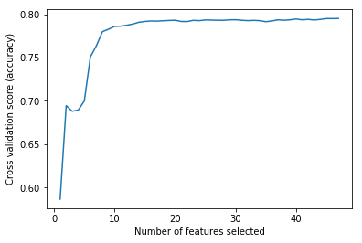
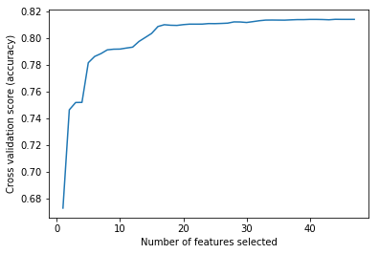
Recursive Feature Elimination
Decision Tree
# features = 15;
Logistic Regression
# features = 20;
Notes:
They performed RFE on these models and found out that the least number of features without significant fall in performance are 15 and 20 for decision tree and logistic regression respectively.

Slide 25
Recursive Feature Elimination
KNN?
Sklearn’s implementation does not have feature importance metrics
to undergo feature selection.
Reference: sklearn.neighbors.KNeighborsClassifier — scikit-learn 1.1.3 documentation
Notes:
However, Scikit-learn’s implementation of kNN doesn't support feature selection, so all 47 features are used for kNN.
Note: This is fine since the number of features is less than one-fifth of the number of data instances, a rule of thumb provided in the lecture.

Slide 26
Mitigate Issue 3 🧹
Models | Features Selected
KNN | All 47 features
Decision Tree | 'freq_qid1', 'freq_qid2', 'q1len', 'q2len', 'chebyshev', 'canberra', 'cityblock', 'word_mover_distance', 'skew_q1', 'skew_q2', 'cwc_max', 'csc_max', 'ctc_max', 'token_set_ratio', 'longest_substr_ratio'
Logistic Regression | 'freq_qid1', 'freq_qid2', 'word_share', 'freq_sum', 'freq_diff', 'braycurtis', 'cosine', 'correlation', 'euclidean', 'squared_euclidean', 'skew_q1', 'kurtosis_q1', 'cwc_min', 'csc_max', 'ctc_min', 'ctc_max', 'abs_len_diff', 'token_sort_ratio', 'token_set_ratio', 'longest_substr_ratio'
Reference: 47 features selected
Notes:
This table shows the most important features for the three models.

Slide 27
Let’s start training! 🏋️
Summary of data cleaning done:
correct labels of erroneous data
undersampling to mitigate data imbalance issue
feature selection to mitigate Curse of Dimensionality
We are ready to train!
Notes:
After data cleaning and reducing dimensionality, they are ready to train the models.

Slide 28
Hyperparameter Optimization 📈
Find out the most optimal value of hyperparameters:
KNN - n_neighbours
Decision Tree - max_depth
Logistic Regression - C (inverse of regularisation parameter)
Settings: Cross Validation on the training set
Notes:
Alice and Bob used cross validation on the training set to find out the optimal value of hyperparameters for the different models, which are number of neighbours for kNN, max depth for decision tree, and inverse of regularisation parameter for logistic regression. to increase the models’ performance.

Slide 29
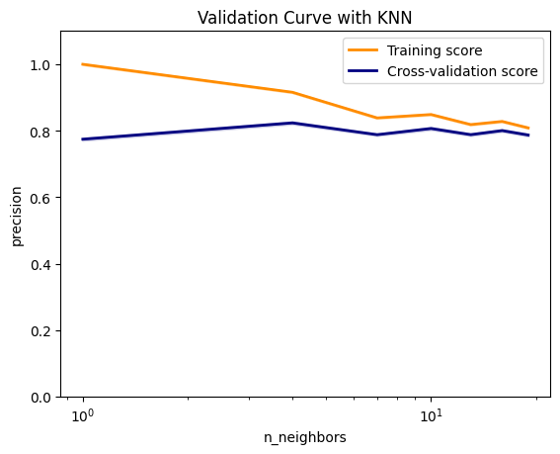
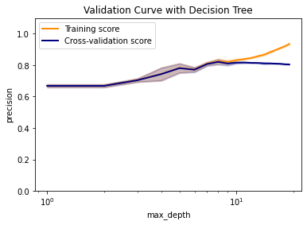
Hyperparameter Optimization 📈
KNN
n_neighbours = 4
Decision Tree
max_depth = 8
20
Notes:
From the graphs, the optimal number of neighbours is 4 for kNN. For decision tree, 8 is the optimal max depth.

Slide 30
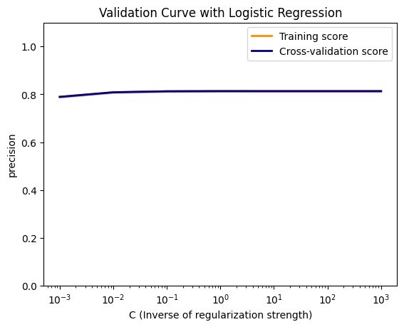
Hyperparameter Optimization 📈
Logistic Regression
C = 1.0
Notes:
For logistic regression, the optimal inverse of regularisation parameter C is 1.
Highest point
https://stats.stackexchange.com/questions/332838/how-to-interpret-stable-and-overlapping-learning-curves

Slide 31
MACRO👐
ANALYSIS
Notes:
Now let's look at the macro analysis of Alice and Bob’s models.

Slide 32
Performance Metrics
Alice and Bob decided to focus on precision.
False positives are more costly (marking question pairs as duplicate when they are not).
Notes:
They decided to focus on precision because if they mislabelled questions that are different as duplicates, this may lead to these questions being removed from Quora.

Slide 33
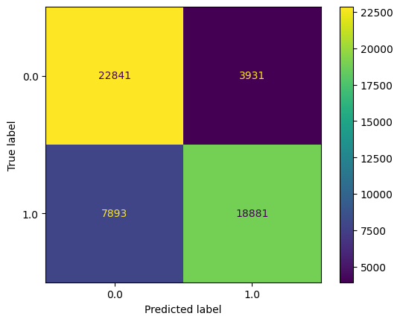
Analysis: k-Nearest Neighbours
 | precision | recall | f1
0 (not duplicate) | 0.74 | 0.85 | 0.79
1 (duplicate) | 0.83 | 0.71 | 0.76
macro avg | 0.79 | 0.78 | 0.78
weighted (micro) avg | 0.79 | 0.78 | 0.78
accuracy |  |  | 0.78
Notes:
The confusion matrix and different performance metrics for kNN are shown here. The macro and micro average for precision are 0.79.
Note: Can mention lecture slide to explain why macro and weighted are the same

Slide 34
Analysis: k-Nearest Neighbours
K-Nearest Neighbours
Difficult for detailed analysis.
Every feature is treated equally after scaling. Distances are similar in high dimensions.
Less insightful.
Notes:
Further detailed analysis of kNN is difficult. After scaling, the value of every feature is between -1 and 1. Since kNN relies on difference in feature distance, every feature will produce a similar effect.

Slide 35
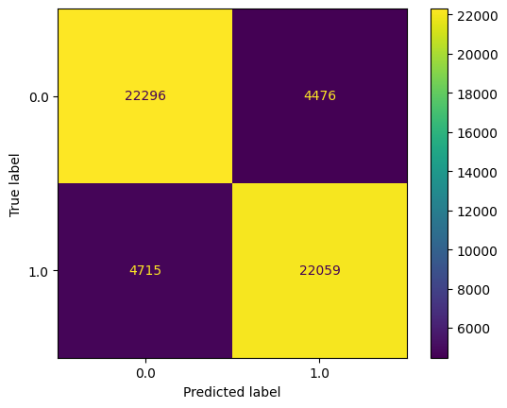
Analysis: Decision Tree
 | precision | recall | f1
0 (not duplicate) | 0.85 | 0.79 | 0.82
1 (duplicate) | 0.80 | 0.86 | 0.83
macro avg | 0.83 | 0.83 | 0.83
weighted (micro) avg | 0.83 | 0.83 | 0.83
accuracy |  |  | 0.83
Notes:
For decision tree, the macro and micro average for precision are 0.83.

Slide 36
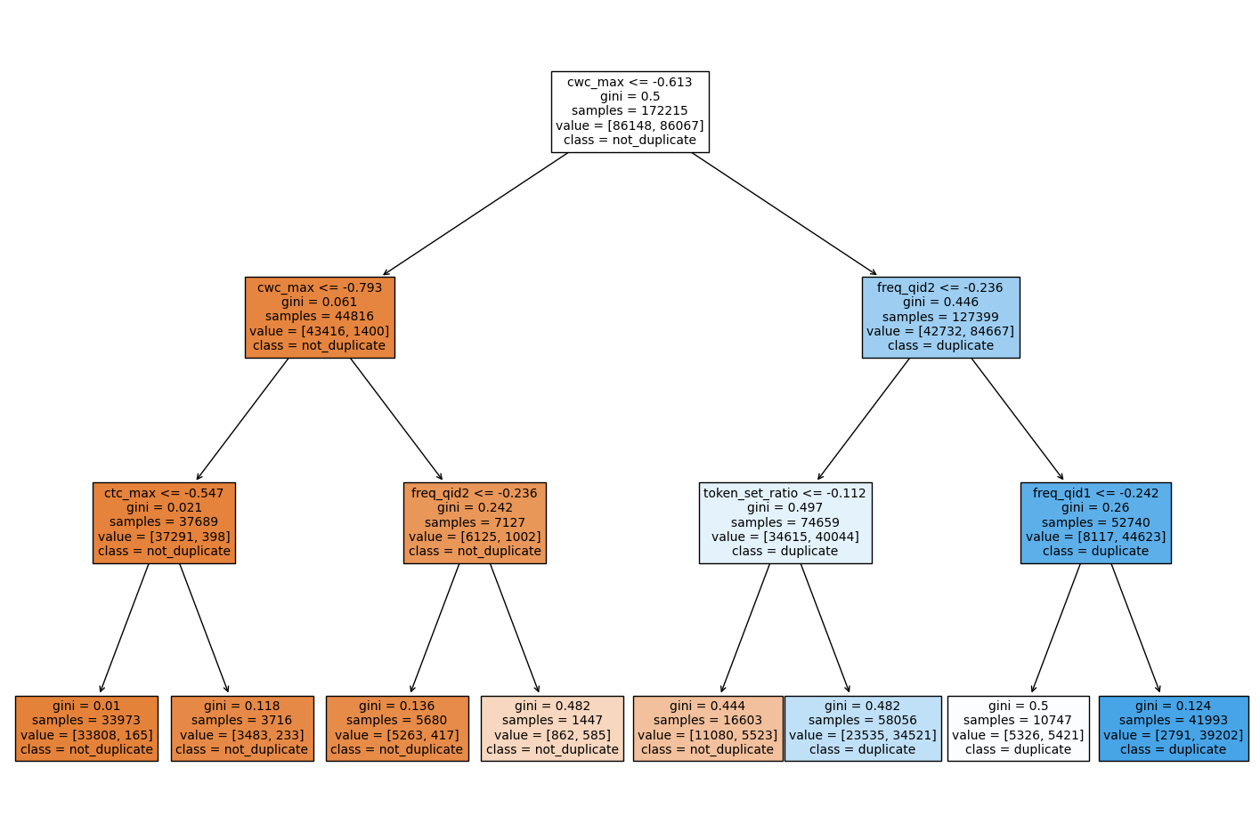
Analysis: Decision Tree
Zoom in to depth
= 3
First chosen feature
= cwc_max (ratio of common_word_count to max length of word count of Q1 and Q2)
Notes:
Looking at the decision tree, Alice and Bob discovered that the first chosen feature to split on is cwc_max, which is the ratio of common word count to the max length of word count of question 1 and 2.

Slide 37
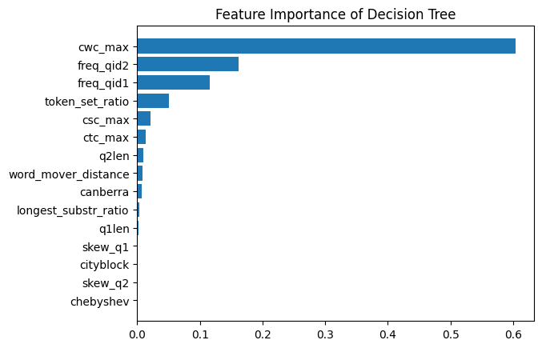
Analysis: Decision Tree
Notes:
Besides that, the frequency of question 2 and question 1 are the next most important features that the decision tree uses to split the data.

Slide 38

Analysis: Logistic Regression
 | precision | recall | f1
0 (not duplicate) | 0.81 | 0.81 | 0.81
1 (duplicate) | 0.81 | 0.81 | 0.81
macro avg | 0.81 | 0.81 | 0.81
Weighted (micro) avg | 0.81 | 0.81 | 0.81
accuracy |  |  | 0.81
Notes:
Moving on to logistic regression, the macro and micro average for precision are 0.81.

Slide 39
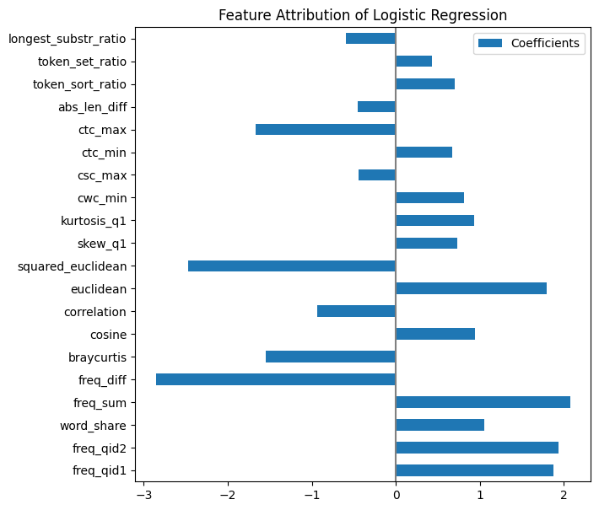
Analysis: Logistic Regression
Positive coefficient
=> more likely to be duplicates, vice versa.
The question frequency features are the strongest indicator for being duplicates.
Notes:
This feature attribution graph shows that the question frequency features such as frequency of question 1 and 2, as well as the sum of these two frequencies are the strongest indicators when predicting duplicates.

Slide 40
MICRO🤌
ANALYSIS
Notes:
After obtaining a decently high performance metrics, Alice and Bob were eager to find out how these models would perform at the microscopic level.

Slide 41
Micro Analysis
Let’s compare the prediction of KNN, Decision Tree and Logistic Regression!
Question 1: Am i not a good developer if I don’t use vim or emacs?
Question 2: If I don’t use vim, can I be a good developer?
True label: 1 (duplicates)
KNN: 1
Decision Tree: 1
Logistic Regression: 1
Notes:
They then applied the models to a pair of the questions in the dataset. As you might have guessed, these models are able to predict the result correctly. But that's not saying much, isn't it?

Slide 42
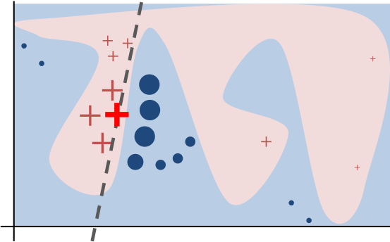
Explainability: Why Should I Trust You?
Alice and Bob want to know what the models are doing! They decide to use LIME!
They perturb the instance they want to explain so that they can learn a sparse linear model around it, as an explanation.
Goals:
Choose between competing models
Get insights into the model
Notes:
This prediction does help to reaffirm my confidence but is that really enough for us to trust the models, asked Alice. Indeed, it would be better if they could understand why the classifiers are making such predictions.
They recall from the CS3244 class that an explanation is a local linear approximation of the model’s behavior. While the model may be very complex globally, it is easier to approximate it around the vicinity of this particular instance and this is essentially the idea of LIME.
Following the idea of LIME, they perturbed this instance so they could learn a sparse linear model around it as an explanation that would help them compare the competing models by getting insights into them.

Slide 43
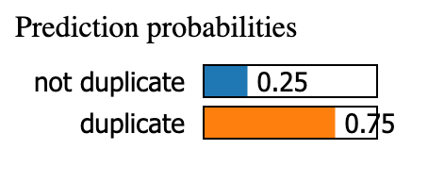
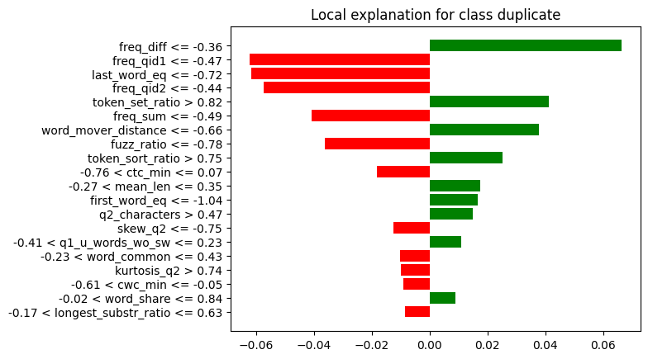
Explainability: KNN
6 out of 8 nearest neighbors are duplicates.
freq_diff is the strongest indicator for the model to make prediction for this case
This implies that it’s related closely with these neighbors by freq_diff.
Notes:
For the KNN model, they observed a confidence level of 75%, implying that 6 out of its 8 nearest neighbours are duplicates.
Besides, as we can see from the local explanation graph, frequency difference is the strongest indicator, meaning that this instance is closely related to its neighbours by this feature.
For the KNN model, they observed a confidence level of 75% and that the frequency difference is the strongest indicator for being duplicates.

Slide 44
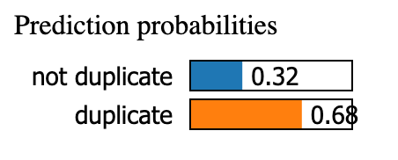
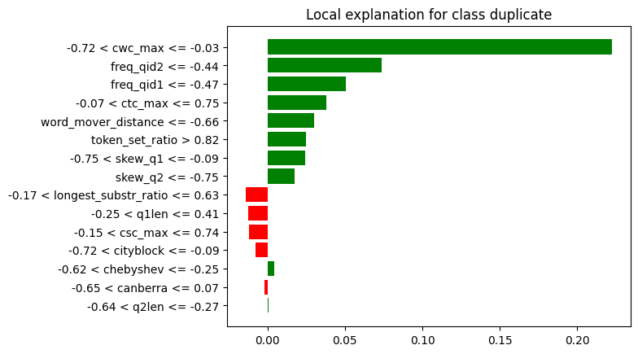
Explainability: Decision Tree
68% of the samples that falls into that leaf are duplicates.
The local explanation highly correlates to the structure of the decision tree.
For example, cwc_max has the largest positive influence and it is indeed the first split condition of the tree.
Notes:
For the decision tree, they observed a confidence level of 68%, implying that 68% of the samples that falls into the leaf are duplicates.
The local explanation is kinda similar to the structure of the decision tree. For instance, the cwc_max feature has the largest positive influence because it is the first split condition of the tree.
For the decision tree, the local explanation is kinda similar to the model structure. For instance, the cwc_max feature has the largest influence because it is the first split condition of the tree as we have seen earlier.

Slide 45
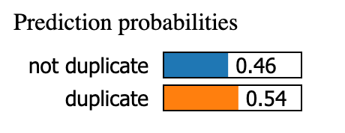
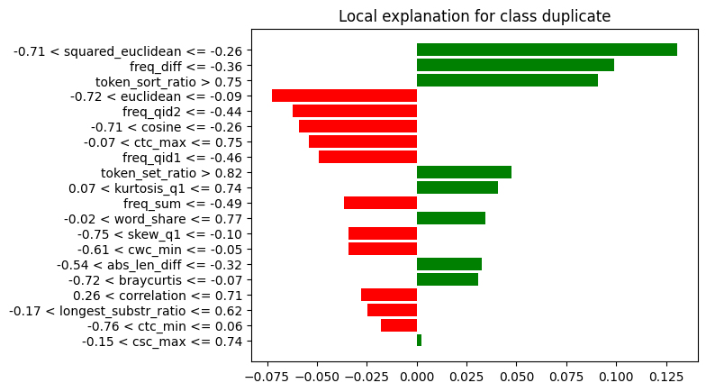
Explainability: Logistic Regression
3 out of top 5 features provide evidence that the two questions are duplicates.
Squared euclidean distance between the two word embeddings is the strongest indicator in this case.
Squared_eucliean has higher weight in this local context.
Notes:
Whereas for the logistic regression, the squared euclidean distance, the frequency difference and the token sort ratio are the main reasons the model decides that these two questions are duplicates.

Slide 46
Explainability: Comparisons
 | KNN | Decision Tree | Logistic Regression
Confidence | 75% | 68% | 54%
% supporting feature among top 5 features | 40% | 100% | 60%
Top supporting feature | freq_diff | cwc_max | squared_euclidean
Notes:
This slide shows the summary of the comparisons between these 3 models.
Alice and Bob noticed that the KNN has the highest confidence level while the decision tree has the largest percentage of supporting features among the top 5 most influential features in each model for this particular instance.

Slide 47
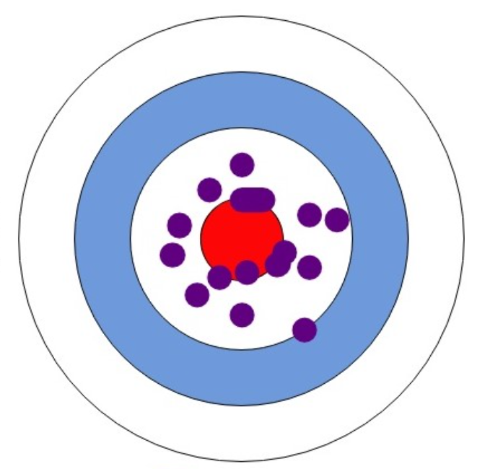
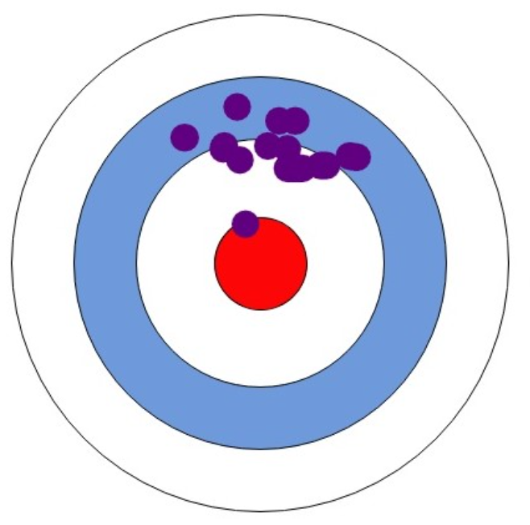
Explainability: Study
Is Logistic Regression inferior?
Is prediction probability really indicative of the model performance?
And this is just an instance level analysis.
Notes:
At first glance, the Logistic Regression appears inferior to the other two models. However, this may not be the case.
Both of these models rely too much on its local community, which makes them really noise sensitive. As we cant be sure that the dataset are completely noise free, this can cause some inaccuracies.
Bob argued that, the prediction probability may not be indicative of the model performance, for example when the standard deviation is large. If a model’s confidence level fluctuates a lot among different instances, then it may not be desirable as Bob would prefer a slightly lower but more consistent prediction probability. Not to mention that this is just an instance level analysis.

Slide 48
HOLD ON…
😱
Why frequency features?
Notes:
Hold on. Bob also noticed another strange phenomenon. How are frequency features relevant in decision making?

Slide 49
Precision falls from
79-83% to 74-81%
after removing features related to frequency
🤯
Notes:
Bob did not believe that these features are actually important, and tried to remove them and retrain the model again. To his surprise, the precision score falls by about 3 - 5%, which is huge.

Slide 50

👀
Strange Observation
More common for popular questions to have more duplicates.
However, including these features in the models may result in poorer performance when encountering new questions.
Notes:
This is truly strange. They wonder how the frequency of questions can influence the prediction decision.
After some thought, it does make sense that it is more common for popular questions to have more duplicates.
However, including these features in the models may result in poorer performance when encountering new questions. They believe this is the trade-off that the Quora admins have to consider.

Slide 51
Research Question 1
KNN, Decision Tree and Logistic Regression are able to predict the result decently well.
KNN requires all 47 features Logistic Regression requires 20 and Decision Tree requires only 15 before the accuracy falls.
There are no most important features to generalise everything as it is dependent on how they approach the problem.
Notes:
To answer their research question 1, all 3 models are able to predict the result quite well, even though each of them requires different number and type of extracted features.
Based on the findings, they come to a consensus that there are no most important features to generalise the problem as it ultimately depends on how the individual approaches the problem. If the individual works like a decision tree, then those 15 features would be enough and the most critical for them to make a decent decision.

Slide 52
Neural Network 🧠
“Let’s also try neural networks!”, suggested by Alice, “deep neural networks can handle input with high dimensions better than the traditional models with the large number of tunable weights, so it works well with our embedding vectors!”
Notes:
Transition into NN

Slide 53
Neural Network 🧠
Immediately, Alice and Bob began building a neural network model.
The input of the model takes in 1536 values, which are taken from the two 768-dimensional vectors generated by BERT using the two questions.
Input:
1536 values
………
Output:
Classification
………
Hidden Layers
Notes:
Discuss general architecture, essentially mention input output

Slide 54
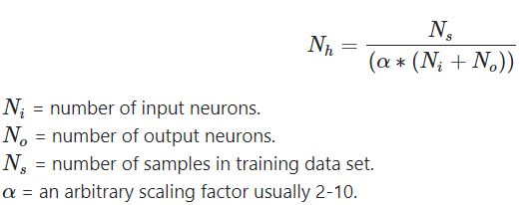
Neural Network 🧠
To decide the number of hidden layers and neurons to use, Bob researched online and found a rule-of-thumb formula.
Using the formula, Bob decided to use 10 hidden layers, each with 150 neurons.
Notes:
Explain choice of neural network size

Slide 55
Neural Network 🧠
After about 50 epochs of training and validation score has stabilized, Bob proceeds to evaluate the performance using the test data!
Notes:
Transition to evaluate

Slide 56
MACRO👐
ANALYSIS
Notes:
Now let's look at the macro analysis of Alice and Bob’s models.

Slide 57
Analysis: Neural Network
Classifier Used: hidden layer size (150, 10), ReLU activation, Adam solver with validation early stopping.
Terminated after 49 epochs at 0.276 loss (from 0.54 initially), and the accuracy on test data is 0.81.
 | Precision | Recall | F1
False (non-duplicate) | 0.84 | 0.86 | 0.85
True (duplicate) | 0.75 | 0.73 | 0.74
Macro | 0.8 | 0.79 | 0.79
Micro | 0.81 | 0.81 | 0.81
Confusion Matrix | Predicted
Actual |  | Negative | Positive
 | Negative | 39406 | 6596
 | Positive | 7243 | 19525
Notes:
Show key metrics, not gonna go in depth

Slide 58
Analysis: Neural Network of Different Sizes
Bob also tried to vary the size of the neural network used to check the effect on performance, by evaluating their accuracy on test data.
5-layers | 10-layers (Implemented) | 50-layers
0.8101 | 0.8098 | 0.8119
He found that the accuracies are extremely similar with only a deviation of about 0.01. He concludes that 10 hidden layers is a good middle ground with a decent number of tunable parameters and training speed.
Notes:
Explain the choice of 10-layers and transition with “next let’s look at the model’s performance at a micro level”

Slide 59
MICRO
ANALYSIS
Notes:
Now we will take a look at the micro analysis of Alice's and Bob's models.

Slide 60
Analysis: Neural Network
To understand the neural network, Bob decides to take a look at some misclassifications to attempt to understand what is going on.
Notes:
Bob wants to get an idea of how the neural network works. He decides to take a look at some misclassifications made to attempt to understand what is going on.

Slide 61
Analysis: Neural Network Misclassifications
Some misclassifications found by Bob were as follows:
How is vinyl compared to CD in terms of sound quality? ←→ Is Vinyl better than CD or MP3?
actual 1, predicted 0
What's your best birthday gift? ←→ What are the best birthday gifts?
actual 1, predicted 0
How do I suck it up and lose weight? ←→ How should I lose weight?
actual 1, predicted 0
Notes:
Some false negatives found by Bob are as follows. For example, one question is "What is your best birthday gift?", versus "What are the best birthday gifts?".

Slide 62
Analysis: Neural Network Misclassifications
Some misclassifications found by Bob were as follows:
What are sound waves? ←→ What are transverse and longitudinal sound waves?
actual 0, predicted 1
Do Kashmiris wants to join Pakistan? ←→ Do the people of Kashmir want to join Pakistan or India? Why?
actual 0, predicted 1
Which is better between iphone 6s and Samsung note 7? ←→ Which is better? IPhone 6s or Samsung Note 5?
actual 0, predicted 1
Notes:
Some false positives found by Bob are as follows. For example, one question is "What is your best birthday gift?", versus "What are the best birthday gifts?".

Slide 63
Analysis: Neural Network Misclassifications
By sampling a few incorrect predictions made, Alice and Bob can analyze and attempt to understand why their model is facing difficulties.
They can see that the model appears to encounter difficulties when one question is a more specific version of another.
This often means that the answer for the more specific question can be used to answer the general question, but not all answers of the general question make sense for the more specific question.
As the model does not capture the extent of overlap, it faces difficulty when classifying the questions.
Notes:
Alice and Bob believe that by sampling a few of the incorrect predictions made, they are can attempt to understand why and where their model are facing difficulties.
One interesting pattern is when one question appears to be a more specific version of the other.
Generally, the answer for the more specific question can be used to answer the general question, but the same cannot be said for the other way around.
Alice and Bob believe that the model has not managed to capture the extent of the overlap between the questions, and therefore faces difficulty when classifying them

Slide 64
Analysis: Neural Network Misclassifications
Examples of such questions are:
1) What are sound waves? ←→ What are transverse and longitudinal sound waves?
actual 0, predicted 1
2) What's your best birthday gift? ←→ What are the best birthday gifts?
actual 1, predicted 0
3) How is vinyl compared to CD in terms of sound quality? ←→ Is Vinyl better than CD or MP3?
actual 1, predicted 0
Notes:
One example is "What are sound waves?" versus "What are transverse and longitudinal sound waves?". While the questions appear similar, they are fundamentally a bit different, and the neural network predicts that they are similar wrongly.

Slide 65
Analysis: Neural Network Misclassifications
Another instance where the model appears to misclassify instances is when the questions include specific terminologies or slang. This may be due to the embedding generation method not receiving enough training data that include product names or slang.
Notes:
Another pattern that Alice and Bob managed to find is when questions include specific terminologies or slang. Alice and Bob believe that one possible reason is that the embedding generation method did not capture these features well.

Slide 66
Analysis: Neural Network Misclassifications
Example of such questions are:
1) Which is better between iphone 6s and Samsung note 7? ←→ Which is better? IPhone 6s or Samsung Note 5?
actual 0, predicted 1
2) How do I suck it up and lose weight? ←→ How should I lose weight?
actual 1, predicted 0
Notes:
Examples of such question pairs are: "Which is better between iphone 6s and Samsung note 7?" versus "Which is better? IPhone 6s or Samsung Note 5?" and "How do I suck it up and lose weight?" ←→ "How should I lose weight?"

Slide 67
Explainability: Neural Network
Due to the use of BERT as a black-box, it is hard to fully understand why the neural network has such misclassifications.
While it is possible to identify question pairs where misclassification occurs, explainability is hard as Bob would need to understand the output of BERT, and on top of that, the learned features of his own neural network.
This is one potential tradeoff with using a neural network for classification.
Notes:
Unfortunately, it is also clear that sampling misclassifications may not give a full picture of where the model is really going wrong. Alice and Bob realise that any patterns they spot may not be the correct answer.
Due to the use of BERT as a black-box to embed question pairs, it is not clear what features are captured in the 768 dimensional embedding provided. On top of that, with the use of the simple neural network as another black-box on top, attempting to understand how the model works becomes rather difficult.
For example, misclassifications could be due to BERT not capturing potentially useful features of the questions, or because the model used by Bob was unable to capture the features generated by BERT. Ultimately, the fact that the black-boxes makes explainability a lot more difficult is one potential tradeoff that should be taken into consideration.

Slide 68
👀
Strange Observation 2
Alice and Bob found that both neural networks and traditional models (kNN, decision tree, logistic regression) have similar performance (f1, precision, recall).
They wondered if there are other cases out there … …
Notes:
As they discovered earlier, Alice and Bob found that both neural networks and traditional ML models (kNN, decision tree and logistic regression) have comparable performance in terms of f1 score, recall and precision. They wonder why that is?

Slide 69
Research Question 2:
Performance of NN vs Traditional Models
Classifier | Cohen’s κ
CNN (Hua et al., 2021) | 0.528
Decision Trees & Random forest (Kovanovi´c et al., 2016) | 0.63
Notes:
Upon further research on the internet, they discovered other great ML scientist have encountered this strange finding too!
In fact, Hua et al discovered in their paper on the analysing cognitive presence in online discussions that CNN have similar cohen scores as decision trees and random forests. Cohen’s kappa measures the agreement between 2 classifiers, more on that later.

Slide 70
Research Question 2:
Performance of NN vs Traditional Models
Classifier | Accuracy
gcForest | 99.26%
SVM (rbf kernel) | 98.60%
Random Forest | 96.80%
Deep Belief Net (Hinton et al., 2006) | 98.75%
Deep Forest: Towards an Alternative to Deep Neural Networks
(Zhou et al., 2017)
Notes:
Likewise, another paper by Zhou et al on alternatives to deep neural networks found that traditional models such as gcForest, RBF SVMs and random forest fared similarly to deep learning models in terms of accuracy, hovering around 97-98%.

Slide 71
Future Improvements
🪄
Notes:
Having completed their findings, Alice wonders if their project could be enhanced by cutting edge technology out there? So, they did more research.

Slide 72
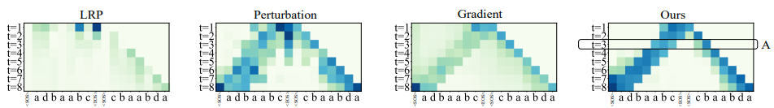
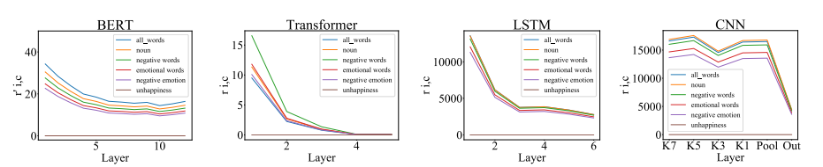
Neural Networks: Hidden layers unhiddened
Fig: Saliency maps
Fig: Layerwise analysis of word categories
Reference: Towards a Deep and Unified Understanding of Deep Neural Models in NLP (Guan et al, 2019)
Notes:
While training the neural networks, Alice and Bob were curious what happens in the hidden layers.
After some digging, they came across a research paper on generating XAI visualisation interpreting what goes on in the hidden layers.
One such visualisation is the saliency maps which shows how each much letter is processed at each layer, this can be extended to words and phrases.
Another graphic depicts the how much each each word category processed in each layer.

Slide 73
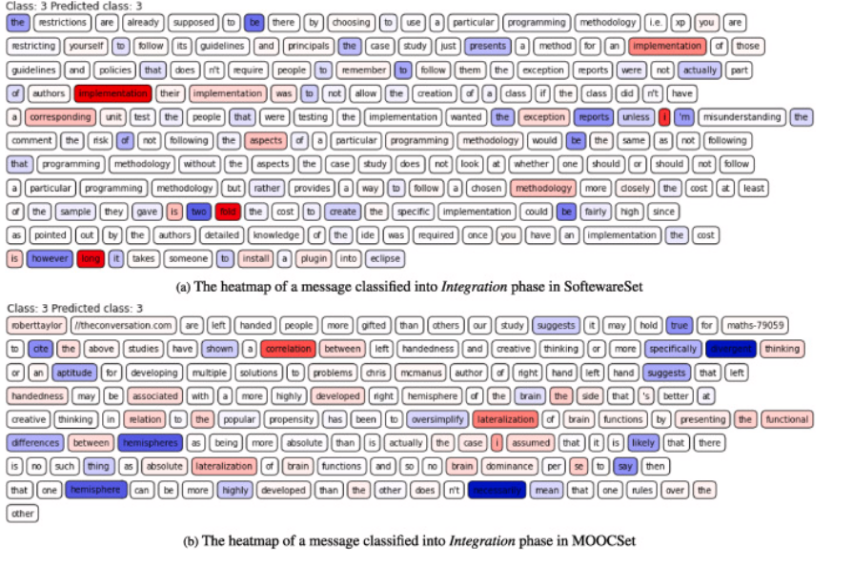
Heat maps to explain NN
Heat map shows relative importance of each word to prediction outcome
can approximate the relative weights given to each word
Fig: Heat map of messages
Reference: Automatic analysis of cognitive presence in online discussions: An approach using deep learning and explainable artificial intelligence (Hua et al., 2021)
Notes:
Another paper suggested generating a heat map of messages. It colors the individual words based on how important the word is to the prediction outcome. This is based off the same study on detecting cognitive presence earlier. From the shading, we can approximate the relative weights given to each word.

Slide 74
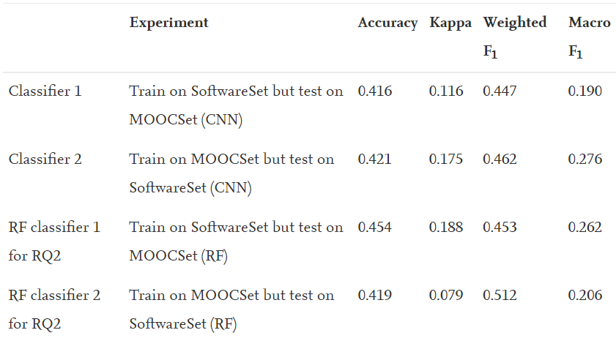
Other evaluation matrices
Cohen’s Kappa can alternative to accuracy, macro F1
Used to measure the similarity in performance between 2 classifiers
Accounts for class imbalances
Accounts for agreement happening by chance
Fig: Evaluation matrices
Reference: Automatic analysis of cognitive presence in online discussions: An approach using deep learning and explainable artificial intelligenceHua et al., 2021
Notes:
An alternative matric to the classic accuracy/f1/precision and recall is Cohen’s kappa score mentioned earlier. It measures how much 2 classifiers agree in their performance. Unlike accuracy, it accounts for class imbalances. More importantly, it accounts for the chances of agreement happening by chance.

Slide 75

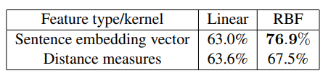


What about SVMs?
Feature engineering:
Table: Accuracy of linear, RBF SVMs on results of method1, method2
Method 1: Sentence embedding vector:
Method 2: Distance measures¹:
Reference: Natural Language Understanding with the Quora Question Pairs Dataset (Sharma et al, 2019)
BrayCurtis distance, Canberra distance, Chebyshev distance, City Block distance, correlation distance, Cosine distance,
Notes:
Bob wondered if anybody used SVMs on the question pairs. Then he found that Lakshay et al used SVMs on the same dataset they used. From each word/token, they used GloVe to generate a 50 dimension vector. The vectors of the tokens in the sentence are summed to get the word embedding for each sentence. Then, they processed the vectors in 2 separate ways.
First, stack the first word embedding on the second to get a 100 dimension vector.
Second, instead of stacking the word embeddings, calculate the distance between the 2 embeddings of each pair of questions.
They then fed the vectors of the two methods through a linear and a RBF (non-linear) SVM separately.
The results were reported on the the table on the right.

Slide 76
Overall Findings
Research Question 1:
kNN, Decision Tree and logistic regression perform decently well only with at least 47, 20, 15 features respectively.
No “most important” feature, depends on approach.
Research Question 2:
Deep NN and traditional ML models have similar performance on quora question pairs
Notes:
In sum, Alice and Bob wanted to find out which model best solves the age old problem of duplicate questions.
After training and testing the traditional models, they found kNN, decision trees and logistic regression need at least 47, 20 and 15 features to perform well. There is no cardinal feature, it depends how the individual approach the problem.
After they trained the neural network, they found it performed similarly to the traditional models.

Slide 77

THANKS!
🤝
Notes:
We have come to the end of our presentation, thank you for listening.

Slide 78
References
Despraz, J., Gomez, S., Satizábal, H. F., & Peña-Reyes, C. A. (2017). Towards a better understanding of deep neural networks representations using Deep Generative Networks. Proceedings of the 9th International Joint Conference on Computational Intelligence. https://doi.org/10.5220/0006495102150222
Hu, Y., Mello, R. F., & Gašević, D. (2021, October 29). Automatic analysis of cognitive presence in online discussions: An approach using Deep Learning and Explainable Artificial Intelligence. Computers and Education: Artificial Intelligence. Retrieved November 16, 2022, from https://www.sciencedirect.com/science/article/pii/S2666920X2100031X
Sharma, L., Graesser, L., Nangia, N., & Evci, U. (2019). Natural Language Understanding with the Quora Question Pairs Dataset. ArXiv: Computation and Language. Retrieved 2022, from https://arxiv.org/ftp/arxiv/papers/1907/1907.01041.pdf.
Zhou, Z.-H., & Feng, J. (2017). Deep Forest: Towards an alternative to deep neural networks. Proceedings of the Twenty-Sixth International Joint Conference on Artificial Intelligence. https://doi.org/10.24963/ijcai.2017/497

